Slide 2
Docker
Kubernetes

Slide 3
Kurt - Amende
Worked in Knowit Amende since Nov. 2017
Worked with docker since 2016
Worked With Kubernetes since 2018.

Slide 4
Download from github
https://github.com/kurt70/dockerk8sworkshop

Slide 5
Who are you (short)
Git clone https://github.com/kurt70/dockerk8sworkshop
Make a nametag
Name – (Write nametag)
Current Assignment
Expectations for the Workshop

Slide 6
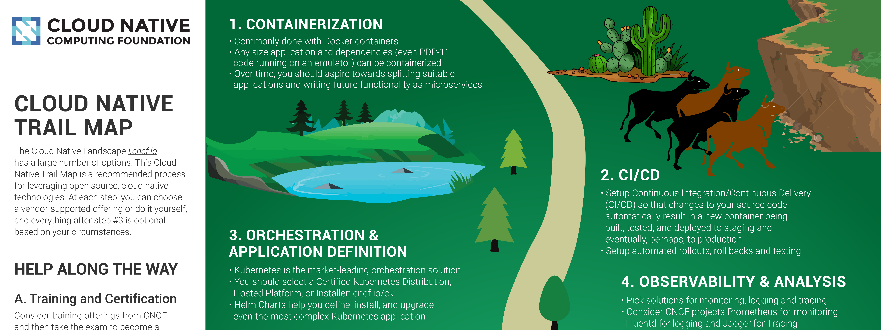
What is changing in the industry
https://landscape.cncf.io/

Slide 7

What is Containers
Docker Inc invented it
Open sourced 2015
Renamed OCI – Open Container Initiative
Container runtimes - Runs virtual containerized workloads
(Usually) Minimal size.
Utilizes the host/VM’s kernel OS(Kernel)
Negligible resource (CPU) overhead compared to host install

Slide 8
Why Containers
Isolates different parts of a system
Works on your machine and other machines the same way.
Minimal config hassle (almost)
Does away with ordinary installation issues (more or less)
Can be run In Kubernetes or other orchestration solutions.

Slide 9






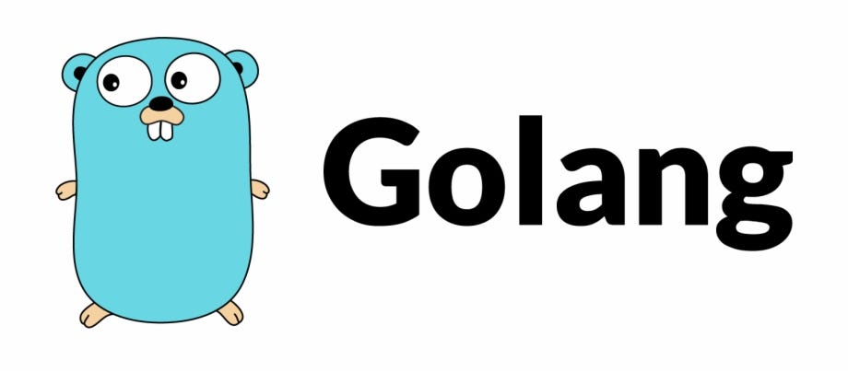






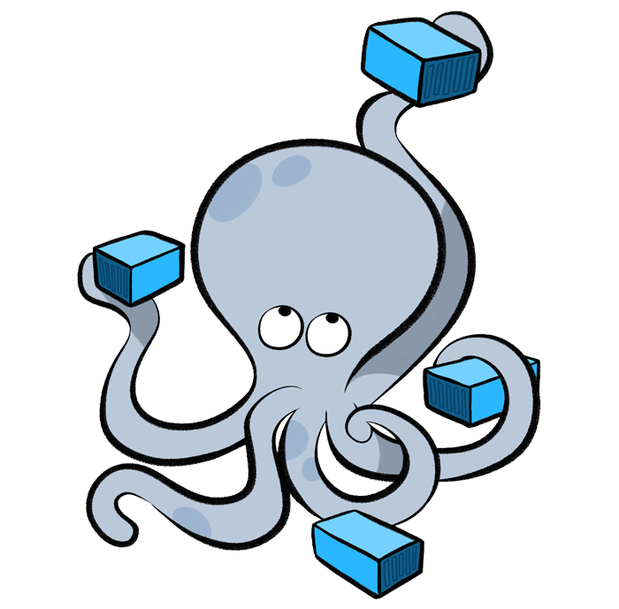
Why Containers cont.
Mix technologies in the same system
Java
.Net Core
Phyton
Etc.
Use open source
MySql
Mosquitto
Kafka
Promotheus
Elastic Search

Slide 10
Example – Home Automation
MQTT (eclipse-mosquitto)
Homeassistant
TimeSeries DB (InfluxDB)
HW Admin
(Tasmoadmin)
External web proxy
(Traefik)
Hardware
Light1
Light2
Switch1
Temp
Humidity

Slide 11
How – Docker Desktop
Docker CLI
Docker repositories (Docker hub++)
Both private or public repos
Dockerfile
Docker-compose

Slide 12
Docker repositories
Where you get container images
Local
Public
Private
Adress naming (Uri?)
[url/reponame/]application:tag

Slide 13
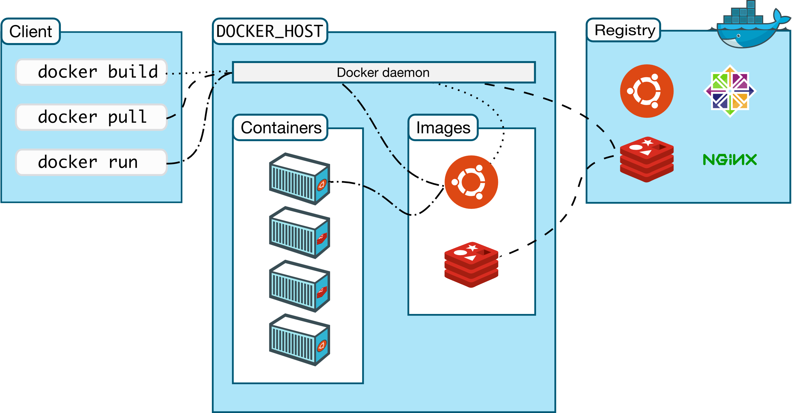
Locally

Slide 14
At the outset – Stateless & not reachable
Any changes in a running docker container is lost upon restart
Need to map hostsystem’s folders to keep state via volume mappings.
Need to map port(s) to host network interface via port mappings.

Slide 15
Exercise – running a container
Docker run –d [–rm] [imagename]
Docker run –p [hostport]:[containerport] [imagename]
Docker run –v [hostfolder]:[containerfolder] [imagename]

Slide 16
How to create our own container
Dockerfile – simple example
docker build -t helloapp:v1 .
Exclude files with .dockerignore
Every RUN/COPY/CMD makes a new layer.
# of layers make the container lager/slower.
Containers should be as small as possible
FROM ubuntu:18.04
COPY . /app
RUN make /app
CMD python /app/app.py

Slide 17
Multistage containers
Makes a larger temporary container
Compiles the code in this container
Outputs the compiled artifacts to a local output folder
Makes a new container from scratch
Copies the final artifacts from the compile container to the new scratch container
FROM golang:1.11-alpine AS build
# Install tools required for project # Run `docker build --no-cache .` to update dependencies RUN apk add --no-cache git RUN go get github.com/golang/dep/cmd/dep
# List project dependencies with Gopkg.toml and Gopkg.lock # These layers are only re-built when Gopkg files are updated COPY Gopkg.lock Gopkg.toml /go/src/project/ WORKDIR /go/src/project/ # Install library dependencies RUN dep ensure -vendor-only
# Copy the entire project and build it # This layer is rebuilt when a file changes in the project directory COPY . /go/src/project/ RUN go build -o /bin/project
# This results in a single layer image FROM scratch COPY --from=build /bin/project /bin/project ENTRYPOINT ["/bin/project"] CMD ["--help"]

Slide 18
Multistage containers cnt.
FROM mcr.microsoft.com/dotnet/core/aspnet:2.2 AS base
WORKDIR /app
FROM mcr.microsoft.com/dotnet/core/sdk:2.2 AS build
WORKDIR /src
COPY . .
FROM build AS publish
RUN dotnet publish "WebAppTest.csproj" -c Release -o /app
FROM base AS final
WORKDIR /app
COPY --from=publish /app .
ENTRYPOINT ["dotnet", "WebAppTest.dll"]

Slide 19
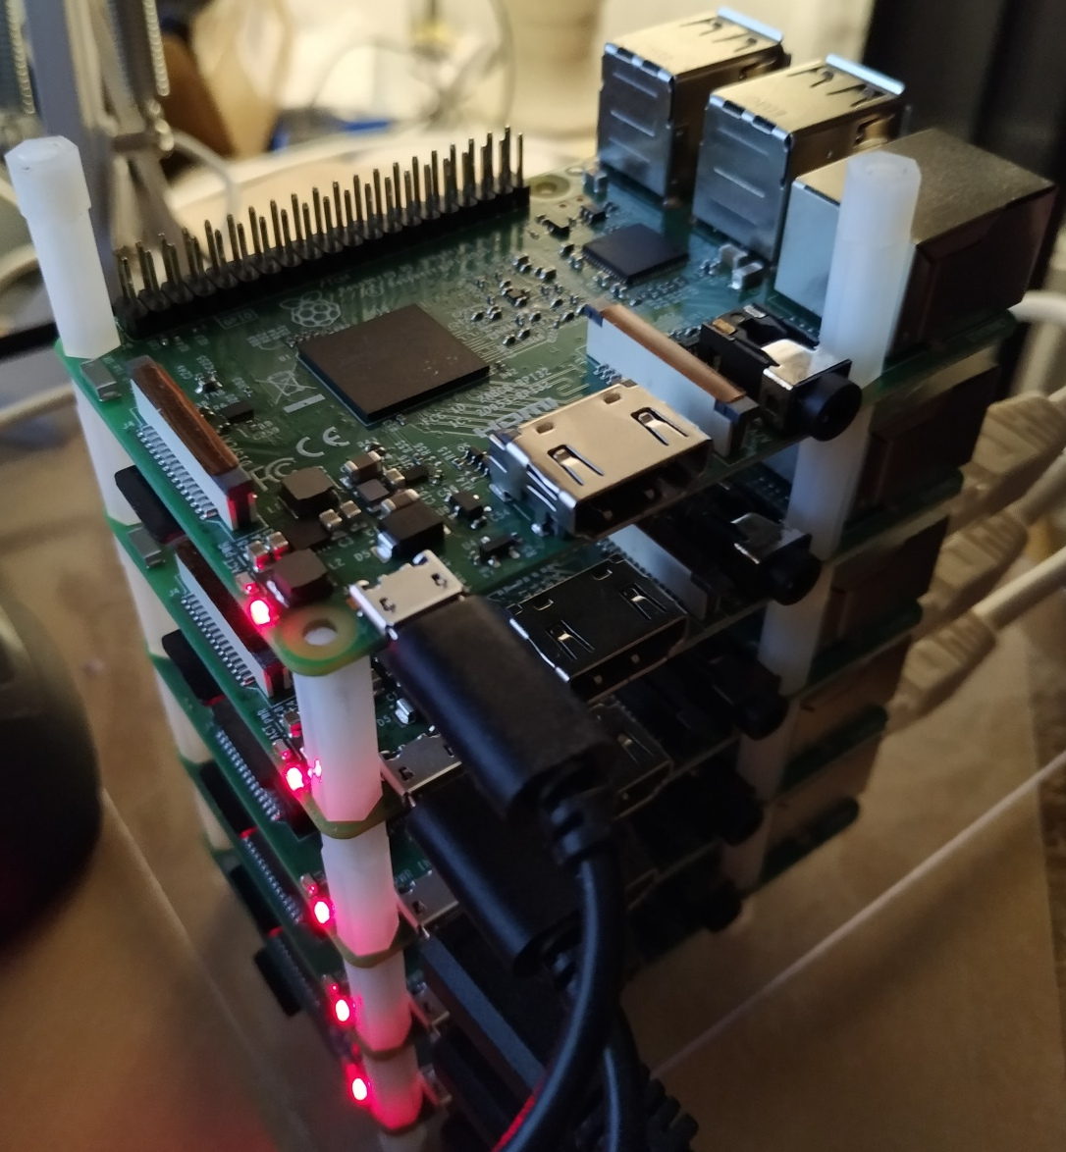
Caveats
Build host, determines processor architecture for end container.
X86/X64 build can only be run on X86/X64 hosts.
ARM build can only be run on ARM hosts.
RPI Clusters is cool, but more difficult….

Slide 20
Alternative OCI container CLI/Runtime/Builder
Podman
Cri-o
Containerd
Buildah

Slide 21
Exercise – Making you own container

Slide 22
Kubernetes (k8s)
Portable
Scalable
Extensible
Open source
Can be used both
Imperatively (cmd line)
Declaratively (config)
“Kubernetes is a portable, extensible, open-source platform for managing containerized workloads and services, that facilitates both declarative configuration and automation”

Slide 23
What does it do
Can dynamically increase/decrease instances of a given container.
Run cron jobs.
Keep track of your config
Keep track of your secrets
Can do dynamic manipulation of running instances
Log aggregations
Monitoring
Etc.

Slide 24
What does it do, cont.
Can run annywhere
Different cloud providers
Bare metal/locally
Hybrid(local/any cloud)
Edge
McDonalds/BurgerKing? POS solutions
Fleet services (Ruter)?

Slide 25
One goal – Easy CI/CD pipeline ++
Same artifacts.
Different config
Containers
Kubernetes yaml files
Easy to move from/to
On prem
Cloud
Hybrid

Slide 26
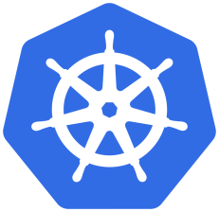
Example pipeline
App/MS repo
Change
New container
Tag container
Push to repo
Change
Version artifact
Version num
repo
Version num
Pull
Config repo
Change
Verify config
Config
Update config
Apply

Slide 27
Demo – CI/CD pipeline

Slide 28
The important stuff
The excact technology is NOT important
Mindset/methodology IS important
COTS – Comercial off the Shelf.
Not reinventing the wheel
Custom code, for custom/spesific problems

Slide 29
K8s – Artifacts
Cluster
Node
Namespace
Deployment
Deamonset
Replicaset
Pod
Service
Ingress
Volumes
VolumeClaims
StorageClasses
Job
Cronjob
HorizontalPodAutoscaler

Slide 30
K8s- Artifacts cont.
Deployment (deploy)
What is deployed
ReplicaSet (rs)
How many instances(pods)
Pod
The actual running instances
Service (svc)
How the deployment is exposed
ClusterIp (only available in the cluster)
NodePort (bound to the nodes NW adapter)
LoadBalancer
Ingress (ing)
Routes external traffic
To service

Slide 31
Lifecycle of a deployment
Cluster
Deployment
Replicaset
Service
Pod1
Pod2
Pod3

Slide 32
Kubernetes «physical» model
Host system (Node)
Client host
Docker VM
Kubelet
Minicube CLI
API srv
Kubectl
Etcd
DNS
k9s
Scheduler
kubens
kubectx

Slide 33
Minikube – «physical» model
Host machine
VM - Minicube
Minicube CLI
Kubernetes – master node
Docker
Proxy
Etcd
Pod
Pod
Pod prosess
Kubectl
Pod prosess
API srv
Scheduler
Pod
Pod prosess
k9s
Pod
Pod
Pod

Slide 34
Kubernetes network model
Cluster
Node1 - master
Node2
Node3
Overlay
Overlay
Overlay
Proxy
Etcd
Proxy
Pod
Proxy
Pod
Scheduler
DNS
Pod
Pod
API srv

Slide 35
Minikube - network model
Hostmachine
Node - master & the rest
Proxy
Etcd
Pod
Pod
Pod
Scheduler
DNS
API srv

Slide 36
Service
ClusterIP
All pods in the cluster
Entry in internal DNS
Ex. http://webapptest/
Not externally exposed
NodePort
Try to bind to the nodes’s host adapter.
(Do not route to other nodes)
LoadBalancer
(Distribute load to all nodes)

Slide 37
Tips & tricks
Best to work declaratively
Yaml
Keep all artifacts in one file
“---” (triple hyphen)
Verify
“kubectl apply –f [yaml file] –dry-run=[client|server]
Apply
“Kubectl apply –f [yaml file]”
Delete
“Kubectl delete –f [yaml file]”
Some changes (ConfigMap++)
Delete pods
Rescale => 0 => x
YAML
Indentation sensitive !IMPORTANT (Pro tip: Use chatGPT for formatting)
Change
Verify
Delete
Test
Apply

Slide 38
Exercise
Try to run our container inside minikube.
Do exercises 2.1 & 2.2
Minikube commands
Minikube status
Minikube start
Minikube stop
Minikube ssh
Minikube update-config

Slide 39
Ingress
Part of the Kubernetes API
Not implemented out of the box
Third party providers
NGINX
Traefik
Many more
Functionality
SSL &TLS termination
Path rewrites
Etc.

Slide 40
Forwarding proxy
“kubectl port-forward [service/deployment/pod] [hostport1:localport1] [hostport2:localport2] …..”
Verify if something is wrong
Temporary access to a pod/svc not externally exposed

Slide 41
Exercise
Make an ingress:
Do exercise 2.3

Slide 42
Configuration
env:
- name: INFLUXDB_HTTP_ENABLED
value: "true"
- name: INFLUXDB_HTTP_BIND-ADDRESS
value: ":8086"
ConfigMap
Name-value lists
Files
envFrom:
- configMapRef:
name: dotnet-config
- configMapRef:
name: kundeportal-config
apiVersion: v1
kind: ConfigMap
metadata:
name: kundeportal-config
data:
name1: "value"
name2: "value"

Slide 43
Configuration cont.
Secret
Name
Base64 encoded value
envFrom:
- secretRef:
name: kundeportal-secrets
apiVersion: v1
kind: Secret
metadata:
name: kundeportal-secrets
data:
ConnectionStrings__MySql: c2VydmVyPT44

Slide 44
Volumes
Volume (PV)
Maps to different storage solutions
Local (node filesystem)
NAS (NFS)
Etc.
VolumeClaim (PVC)
Indirectly attach to volume
Specify requirements
StorageClasses (SC)
Prepackaged specifications for where/how
Minicube default storage
VMs local filesystem ()

Slide 45
Exercise
Use config maps, volumes & secrets:
Do exercise 2.4 & 2.5

Slide 46
Resources
Requests
Min amomunt of ram & cpu
Limits
Max amount of ram & cpu
Memory
Mi – amount of MB RAM
CPU
m – 1000 part of a processor
500m - 0.5 processor
Production - Don’t use.
Autoscaling of nodes.
Low limit – crash/unstability
containers:
- name: db
image: mysql
resources:
requests:
memory: "64Mi"
cpu: "250m"
limits:
memory: "128Mi"
cpu: "500m

Slide 47
Security
Service Account (SA)
Default SA – all pods
Specify – for extended rights
Role
What is allowed – k8s API
For a single namespace
Default – Default NS
RoleBinding
Connect SA to Role
ClusterRole
Clusterwide rights
All namespaces
ClusterRoleBinding
serviceAccountName: metrics-reader
containers:
- image: nginx
name: nginx

Slide 48
Liveness - health
spec:
containers:
- name: liveness
image: k8s.gcr.io/busybox
args:
- /bin/sh
- -c
- touch /tmp/healthy; sleep 30;\
rm -rf /tmp/healthy; sleep 600
livenessProbe:
exec:
command:
- cat
- /tmp/healthy
initialDelaySeconds: 5
periodSeconds: 5
Is the pod healty
LivenessProbe
Can poll a url
Run a command
Fail/succeeded rules

Slide 49
Readyness – init time
ports:
- name: liveness-port
containerPort: 8080
hostPort: 8080
livenessProbe:
httpGet:
path: /healthz
port: liveness-port
failureThreshold: 1
periodSeconds: 10
startupProbe:
httpGet:
path: /healthz
port: liveness-port
failureThreshold: 30
periodSeconds: 10
Some Containers needs time to startup
Database initialization
Cache initialization
Etc.
StartupProbe
Can poll a url
Run a command
Fail/succeeded rules
Avoids continuous crashing pod

Slide 50
Context
Kubectl connection file
Cluster address
User credentials
HOME/.kube/config
TXT file
Rename “context.Name”
“kubectl config get-contexts”
“kubectl config use-context [contextname]”
Update context
“minikube update-context”
gcloud container clusters get-credentials .....
az aks get-credentials
Etc.

Slide 51
If something failes
Kubectl get pod/svc/deploy [-o[wide|yaml]
Kubectl describe pod/svc/deploy
Kubectl logs [podname] [-w]
Kubectl exec –it [podname] printenv|sort
Kubectl exec –it [podname] bash|sh|etc.

Slide 52
Exercise
Load test & Timeline database:
Do exercise 2.5

Slide 53
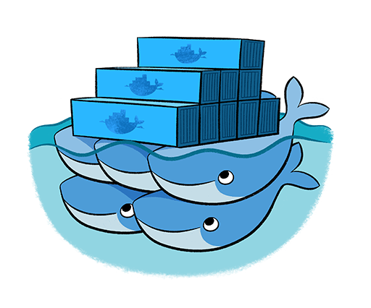

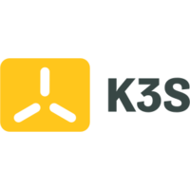



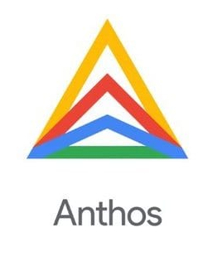
Alternatives & other k8s distributions
Docker compose
Best for local/home setups
Docker Swarm
Hashicorp Nomad
Batch processing+
Kubernetes kubeadm
Production env – difficult to set up
Rancher K3s
K3sup – remote provisioning of k3s nodes
Small footprint( One executable)
Canonical Microk8s
HA setup default
Lots of plugins
Red Hat Open shift
Large scale on prem
Google Anthos
Administer Cloud and on prem clusters from one interface

Slide 54
Resources
https://github.com/kurt70/dockerk8sworkshop.git
https://kubernetes.io/
https://docs.docker.com/
https://hub.docker.com/
https://landscape.cncf.io/

Slide 56


